Slide 1
SEARCH ENGINE OPTIMIZATION

Slide 2
Why is SEO Important?
53% of web traffic comes from organic search.
68% of online experiences begin with a search engine.
93% of global traffic comes from google search, google images and google maps.
SEO – practice of increasing the quantity and quality of traffic to a website through organic search engine results. – Definition
Google cares about E-A-T: Expertise, Authoritativeness and Trustworthiness.
EAT is a great guiding principle in SEO.
SEO is ongoing and cumulative.
SEO can take weeks or even months to start seeing the results.
It is important to start as soon as you can.
SEO is cost effective.

Slide 3
How do search engines rank your content?(Stages of ranking)
Getting your content to rank highly in search engines depends on 2 things:
1. Improving discovery and relevance by creating high quality content on the topics you want to be known for.
2. Building authority by getting lots of high quality links to your website
Discovery, relevance and authority – 3 stages of how SEO works

Slide 4
How to create an SEO strategy
SEO has its own hierarchy of needs.
MOZLOW’S HIERARCHY OF SEO NEEDS.
7. Snippet/schema markup – to standout in SERPs.
6. Title, URL and Description – to draw high CTR in the rankings.
5. Shareworthy content – that earns links citation and amplification.
4. Great UX – including a fast load speed, ease of use and compelling UI on any device.
3. Keyboard optimized – to attract searchers and engines.
2. Compelling content – that answer’s the searcher’s query.
1. Crawl accessibility – so engines can reach and index your page.
You need to fulfill the bottom tiers of the pyramid before you move up.

Slide 5
SEO strategy depends on several factors:
1. How established is your business online.
2. What resources do you have to dedicate to SEO.
3. What industry are you in.
A healthy SEO approach balances building relevance and building authority. i.e creating high quality relevant content while also building high quality back links.
Balancing the two depends on how much authority your website has.

Slide 6
Determining goals for your website and establishing KPIs
By setting goals you can determine if your SEO efforts are paying off
GOALS FOR A WEBSITE.
1. Do you want to increase organic traffic.
2. Do you want to increase the number of leads from your website.
3. Do you want to design a mobile – optimized website.
4. Do you want to make sure your website is accessible for those with disabilities.
It is important to set SMART goals

Slide 7
KPIs – Key Performance Indicators
They are the critical indicators of progress towards a particular goal.
Important indicators to consider include:
1. Organic traffic
2. Keyword ranking
3. Conversion rate
4. Bounce rate
5. Page load time
6. Back links built
Once you know your goals, you can establish your KPIs.
Focus on your users – don’t focus on ”doing SEO”.
Know your audience. Know what they are searching for.

Slide 8
How to measure your website’s SEO authority.
Measuring authority comes down to link volume and quality.
Links are key indicators of a websites SEO authority.
You need to analyze your backlink profile.
Backlink Profile – A list of sites currently linking to your site
A backlink profile measures:
1. The number of inbound links to your website.
2. The number of unique domains that link to your website.
3. The quality of those links – depends on how authoritative the webpages that link to your site are.

Slide 9
Tools to analyze your backlink profile.
1. MOZ
2. Semrush
3. Majestic
4. Ahrefs.
Free version of MOZ – Open Site Explorer.

Slide 10
On Page and Technical SEO
How to optimize content for SEO
On page SEO (Traditional) – process of optimizing various front-end and back-end components of your website so that links and search engines can bring in new traffic.
It is called on page because the changes you make to optimize your website can be seen by your visitors.
Off page and technical SEO elements aren’t visible.
On page SEO is important for both search engines and people – It helps search engines understand your website and its contents.
Google is focused on relevance in order to understand what users are searching for when they type a query and deliver results that meet the users intent.

Slide 11
Google’s “How search works” report states:
“The most basic signal that information is relevant is when a webpage contains the same keywords as your search query. If those keywords appear on the page, or if they appear in the headings or body of the text, the information is more likely to be relevant.”
This means you need to be selective with the keywords you use.
You need to think what would be helpful to people searching and create content to answer their questions.
Optimize one keyword per page.

Slide 12
On Page SEO Elements
1. Heading Tags.
2. Title Tags.
3. External Links.

Slide 13
Page Heading Tag.
HTML elements that provides a hierarchical structure to a webpage.
Well written headings make your page easy to read and navigate. Always put your users first.
Use headings to add structure to your content.
Describe what each section is about so that visitors can quickly find what they are looking for.

Slide 14
Best Practices for Page Headings.
1. Your page title should have an H1 tag.
2. Subsequent headings should have an H2 or H3 tag and so on.
3. Use your primary keyword in your page title.
You are limited to one H1 heading per page.
Search engine crawlers use these tags to scan through your content.
It is unlikely to go any further than an H3.
Make sure to include your target keyword in your page heading. This is about describing your pages content.

Slide 15
Title Tags.
An HTML element that specifies the title of a webpage (also known as the “SEO title”.
A title tag is what is displayed in the search engine result pages(SERPs) and its purpose is to entice people to click on your website.
Create a short title tag.
Use MOZ to preview your title.

Slide 16
Best Practices for Title Tags.
Include your primary keyword in your title tag.
Keep your title under 60 characters if possible.
Make sure both your page heading and tittle answer the searchers primary question.

Slide 17
External Links
It also helps your on page SEO to include external links on your pages. – These are links to other website’s content.
When you link to quality external content it shows your readers and search engines that you have done your research.
Tools to help you improve your content as you write:
1. Yoast SEO plugin for wordpress.
2. Built-in SEO Wiz in Wix.
3. Optimizations in Hubspot page and blog editor.

Slide 18
Allowing Google to index your pages.
On page SEO is all about increasing your discoverability in search engines - You have to allow search engines to access your pages. This is where crawling, indexing and ranking comes into play.
Search engines have 3 primary functions:
1. Crawl – Search web pages and look over the code and content for each URL.
2. Index – Store and organize the information it finds from crawling.
3. Ranking – Provide the pieces of content that best match a person’s search query.

Slide 19
How google finds your content
It uses a set of computers to crawl billions of pages on the web. The crawler begins with a list of webpage URLs generated from previous crawls and then augments those pages with the sitemap data provided.
During crawling process, google bot looks for new sites, updates to existing pages and any broken links.
Once crawling process is complete, all the results are fed into Google's index and any new sites or updated content will be listed accordingly.
While they process the results, google looks at information on your webpage. Eg title tags, meta description, alt tags and more.

Slide 20
How to know which of your pages are already being indexed by google.
Use an advanced search operator – “site:yourdomain.com”. If no content is indexed. You need to create a sitemap.
Sitemap – A file of code that lives on your web server and lists all of the relevant URLs your website carrying.
Your sitemap help search engine web crawlers understand how your website is built.
XML sitemaps are designed specifically for search engines like google
XML sitemap – crucial component of a blog, where article pages are constantly bumped further and further back in a websites archive.

Slide 21
An XML sitemap includes 4 key elements.
URL location – full url to the webpage.
Last modified date – when the page was last updated.
Change frequency – can be set to never, yearly, monthly, weekly, daily, hourly or always.
Priority – number between 0-1 that indicates the priority of the page in a website

Slide 22
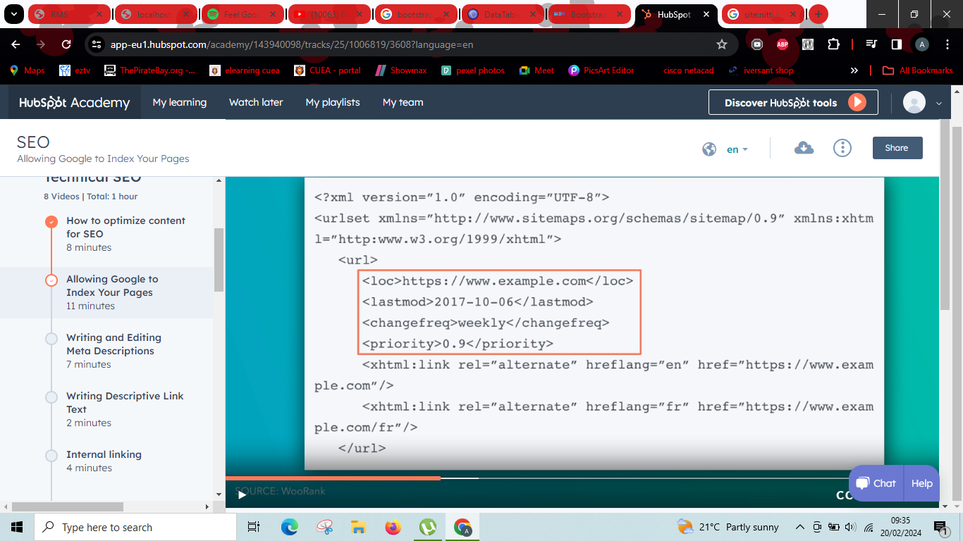
Example of an XML sitemap

Slide 23
Roles involved in structuring a website’s sitemap.
1. Marketing – responsible for defining the structure of the site. (Which pages need to link to one another).
2. Developer – build an XML sitemap file based on the websites structure.
3. Legal – makes sure the site doesn’t have outstanding copyright restrictions.
Pay attention to your websites depth – the further away a page is from the original homepage URL of your site, the worse it is for that pages SEO.
To solve the above: define your home page navigation – you need 2 levels in your website.

Slide 24
After planning how your website will be organized you will:
1. Create the XML sitemap
2. Put it on your webserver
3. Submit it to each individual search engine
If you make a change to your structure you have to submit the XML file again.
Hubspot CMS – submits the file for you.
Free solutions to create your XML sitemap – screaming frog & XML-sitemaps.com

Slide 25
Screaming Frog
Web crawler that helps you access your on page SEO.
It gives you a tool to develop your own XML sitemap and strengthen your website’s SEO in the process.
To use screaming frog:
1. Download the company’s SEO web crawler. Free for the 1st 500 URLs.
2. Create an XML sitemap from it.

Slide 26
How to submit your sitemap to google.
Sign in to google’s search console – This will be your dashboard for testing and submitting updated sitemaps to google.

Slide 27
Writing and editing meta descriptions.
Meta description – HTML attribute that provides a brief summary of a webpage.
3 reasons why you need a meta description:
1. A meta description increases click through rates and visits from organic search.
2. A meta description gives the right people the right information at the right time.
3. A meta description increases visits from social media.
Great meta description can get people to click on your link.
They can help you when people conduct an advanced search.

Slide 28
Advanced Search.
Allows people to specify or exclude terms in search results.
How to conduct an Advanced Search:
1. Explicit Phrase – Use quotes (“”) around the words that you want to appear.
2. Exclude words – Add a minus sign (-) before the word that you want to exclude.
3.This OR That – Add OR in all caps to view results for multiple search terms.
Your meta description drives social media traffic too.

Slide 29
Best practices to write a meta description.
1. Write compelling content.
2. Include one or two keywords.
3. Aim for 155-160 characters – meta description will be cut off if it is too long.
4. Avoid non-alphanumeric characters – They may be removed in the search engine.
Meta description is your chance to convey the value of your page to the viewers.

Slide 30
Writing Descriptive Link Text.
Link description – The clickable words in a hyperlink.
They help users and search engines better understand your content.
The link description should describe the content of the destination page.
Do not use words like click here or learn more.

Slide 31
Link Description Best Practices.
Stay on topic – Do not use text that has no relation to page’s content.
Don’t use the page’s URL unless you are referencing a sites new address.
Keep descriptions concise – Aim for a few words or a short phrase.
Format links so that they are easy to spot.

Slide 32
Internal Linking.
Internal linking – Any link from one page on your website to another page on your website.
Google uses internal links to discover your new site content.
Internal links pass authority from one page to another.
When you link to another page on your site you send link authority to that page.
Backlinks – Links from other websites to your site.
Right internal links help Google learn the following about your pages:
1. Relevance
2. Relationship to your other pages
3. Value

Slide 33
How to determine which pages should link to each other.
Grouping the pages of your site into topic clusters – You can use a tool like Ahrefs site Audit to scan your website for broken links that need fixing and find any orphan pages that no other pages link to.
Make sure that your internal links are follow links to ensure that search engines can follow links between your pages.
Put yourself in your users shoes.
By improving user experience you will also improve your SEO.
SELECT a.`ID`,a.`ItemLookupCode`,a.`Description`,a.`DepartmentID`,a.`UnitOfMeasure`,a.`Price` FROM item a;
\images\9.jpg
\departments\1.jpg

Slide 34
URL structure
URLs were designed to replace IP addresses, which computers use to communicate with servers. It makes the web easier to browse for humans.
Protocol, subdomain, domain name, top level domain, path.
Subdomain can be any name. – you don’t always need it.
Your domain name should be the same as your business name if you are running a business website.

Slide 35
URLs affect your SEO in a few ways:
They improve the user experience.
They are a ranking factor in search engines.
They help users and search engines understand what your content is about.
- Best practices for writing URLs:
Include your primary keyword.
Use hyphen between words.(helps to avoid a long string of words)
Keep them short and simple.
Describe the page contents.
Avoid spaces.

Slide 36
Technical SEO basics.
Technical SEO is the practice of improving technical aspects of a website to help search engines crawl and index it more effectively.
In order to rank in first place, you need strong technical SEO
- Basic technical SEO elements:
1. Robots.txt
2. Canonicalization
3. Protocols
4. Redirect codes
5.Site speed

Slide 37
Structured Data
Resources:
Tool: Google Structured Data Testing Tool
Tool: Google Rich Results Test
Tool: Schema Markup Generator
Website: Schema.org
Tool: WordPress Structured Data Plugins
Tool: Google Structured Data Code Lab
Blog post: JSON-LD for Beginners
Guide: Google Search Gallery
Article: A reintroduction to Google's featured snippets
Blog post: Mega-SERP: A Visual Guide to Google
Blog post: Your Cheat-Sheet for Compressing Images
Blog post: How to Resize an Image without Losing Quality
Blog post: Image Alt Text: What It Is, How to Write It, and Why it Matters to SEO
Blog post: A Comprehensive Guide to Local SEO in 2021

